Slide 1
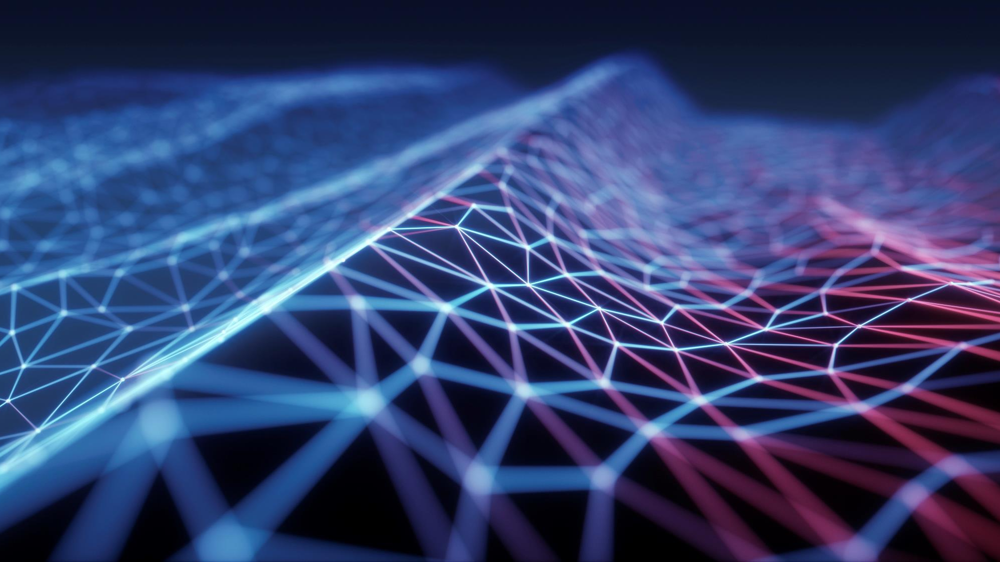
Image , Text & Object Detection
A small project showcasing integration of ai models in webapps

Slide 2
Technologies used
React JS
Tensorflow JS
Tailwind CSS

Slide 3
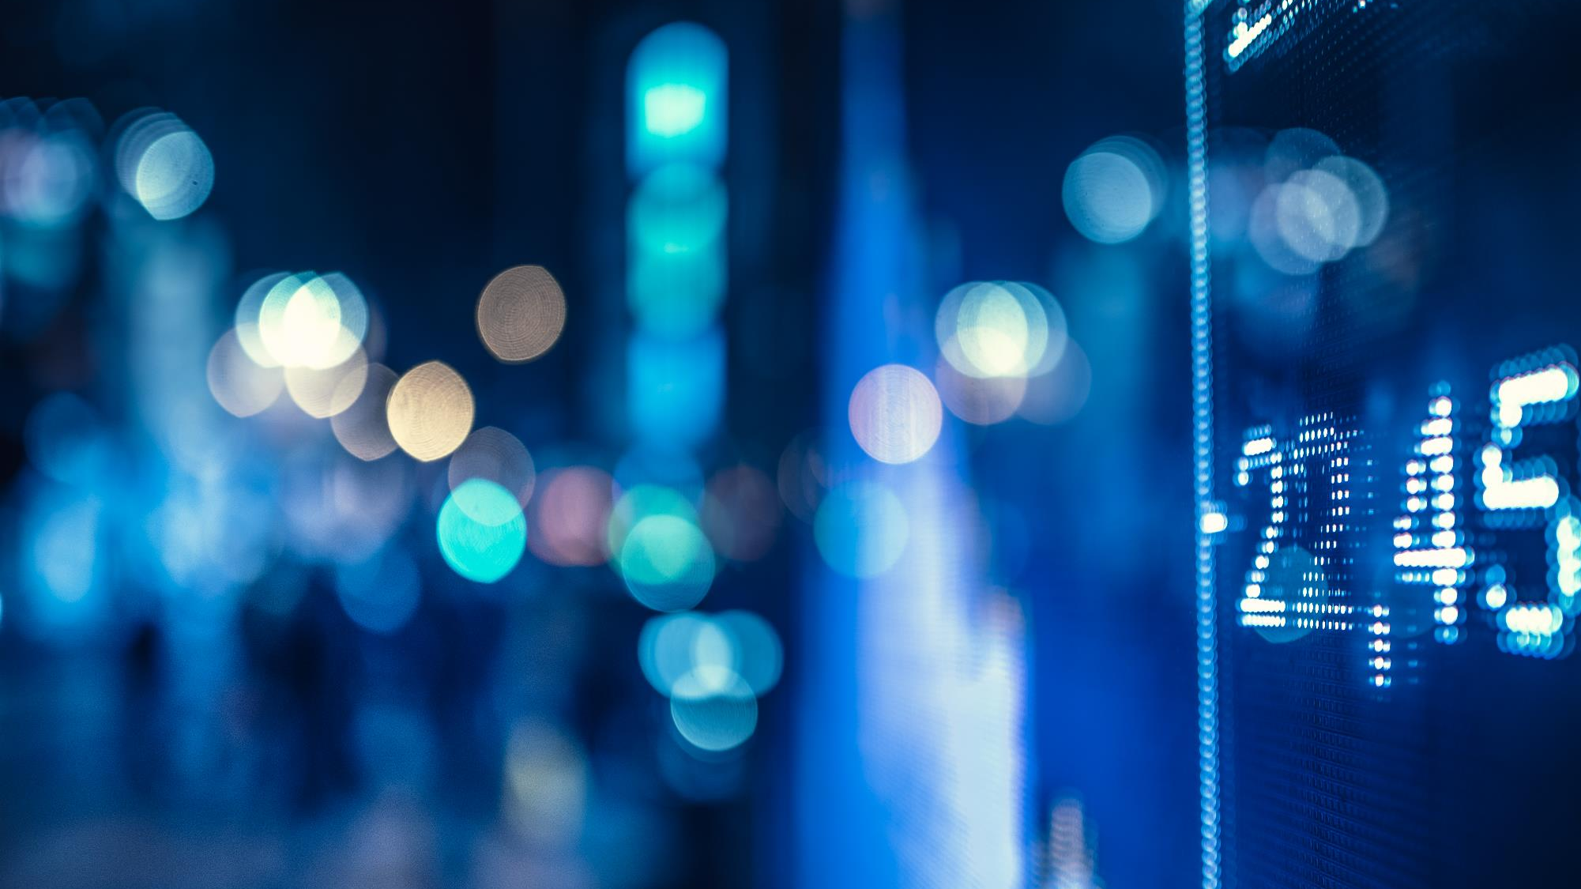
Models used from tensor flow
Mobilenet
Qna
Coco-ssd

Slide 4
Steps taken
Setting up a react app and configuring tailwind css.
Setting up React-router.
Importing Models from tensorflow.
Creating Components.
Implementing functionality in model components.
Using Tailwind css to create the User Interface (UI).
Testing.

Slide 5
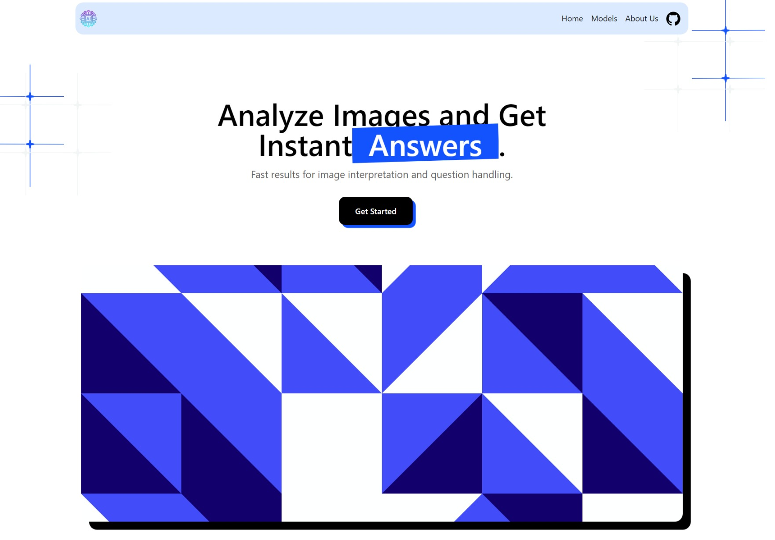
Home page
Key Points:
A header component for switching between pages.
A card component for trying different models.
A content section to learn about technologies used.
A footer section for credits,resources,purpose etc.

Slide 6
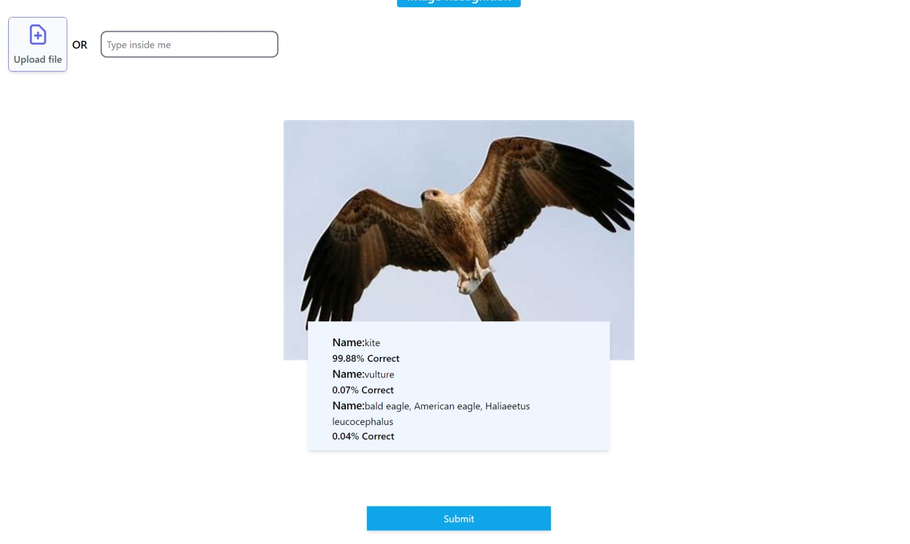
Image recognition model
Key Points:
An image recognition model recognizes the object in the image and displays the results.
A File or url input box is provided which gets the user input.
An Image preview box is also given for previewing images to be recognized.
A text box to display the results.
Note: The results may or might not be accurate because models used are not trained fully and have limitations.

Slide 7
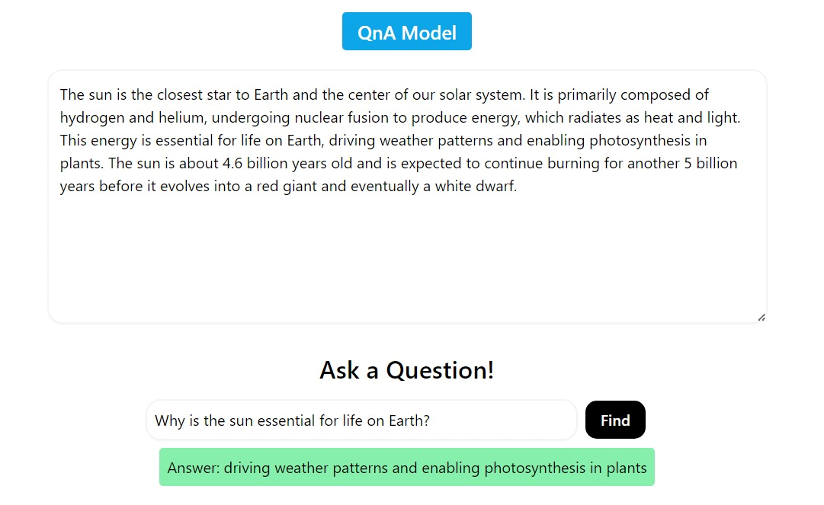
Information extractor
Key Points:
An Information extractor extracts information from a passage inputed by the user and answers the question related to the passage .
It uses Natural language processing to generate answers to questions.
The Whole thing consists of a text box for passage another text box for question and a box for displaying answers.
Note: The results may or might not be accurate because models used are not trained fully and have limitations.

Slide 8
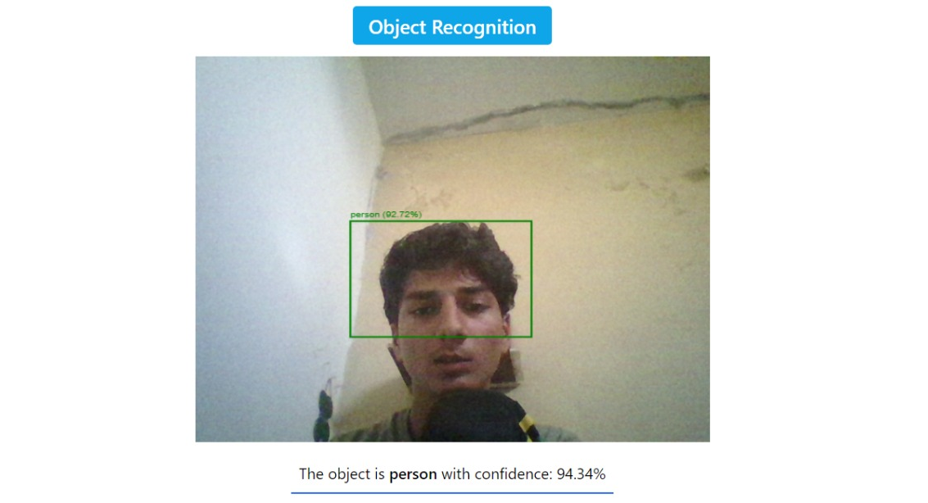
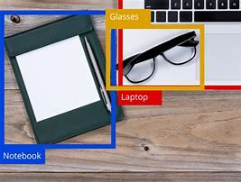
Real-time object detection
Key Points:
A real-time object detector uses a webcam to recognize objects in real-time it can recognize variety of objects but has its own limitations.
It consists of a webcam display on which a the detected objects are highlighted in real-time.
An accuracy meter Is also given to show the accuracy of model.
Note: The results may or might not be accurate because models used are not trained fully and have limitations.

Slide 9
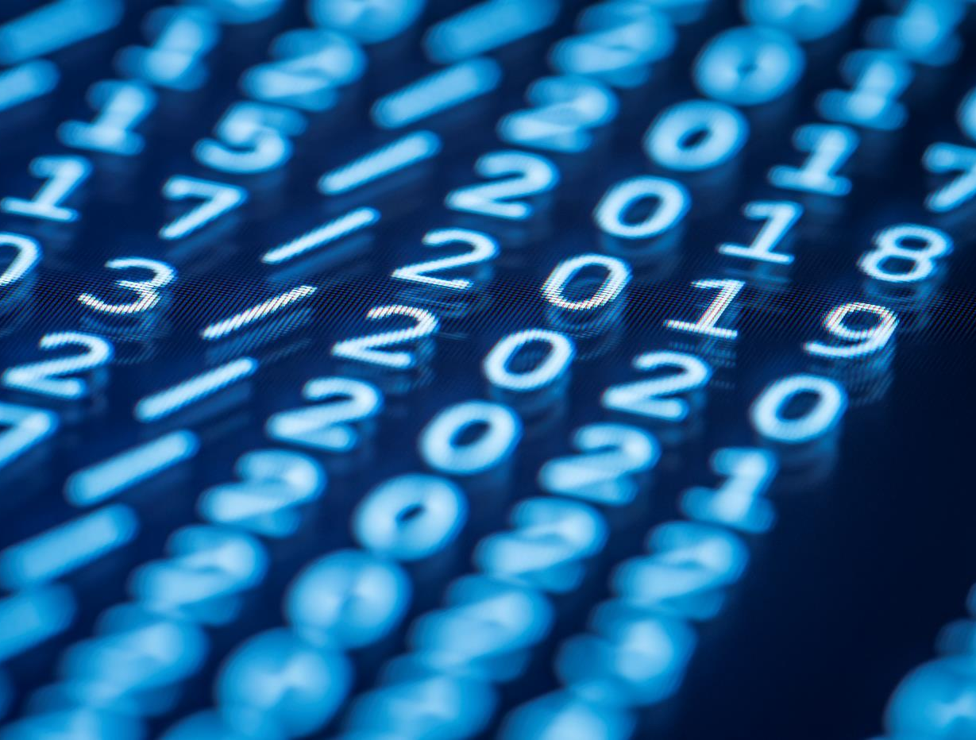
Thank You
CREATED BY:
Ali ABDULLAH
AND
AJLAL SHAH
From xii-e

